Slide 1

MineSafe : IOT Based Smart Helmet for Mining Workers
by
J.R.Yashaswini
Roll No. 204G1A05C5
P. Pavan
Roll No. 204G1A0571
M.Tufel Basha
Roll No. 204G1A05B3
P.Divya
Roll No. 194G1A0528
Under the guidance of
P. Praneel Kumar M.Tech.Ph.D
Assistant Professor
Department of Computer Science and Engineering
Srinivasa Ramanujan Institute of Technology
(Autonomus)
2023 - 2024

Slide 2
Contents
Abstract
Problem statement
Objectives of Project
Literature survey for first objective
Literature survey for second objective
Proposed Work -(Methods to be followed for proposed system)
References
GitHub Link
Queries

Slide 3
Abstract
Mining is recognized as one of the most hazardous occupations in the world. The mining industry has the highest incidence of occupational deaths. In order to reduce these risks and make mining safer, we are focusing on improving the helmets used by workers.
Therefore, the main aim is to make the helmet even safer by adding an array of sensors to monitor environmental conditions, an emergency switch to trigger an alert in case of emergencies, GPS location tracking, along with a WiFi module for IoT communication. Additionally, the helmet incorporates an Accelerometer and Gyroscope sensor for fall detection, as well as a pre-recorded voice provided by a voice processor for alerts. The developed helmet system is primarily intended to improve the working environment in mines and ensure worker safety.
Keywords : Smart Helmet, Sensors, GSM, GPS, Voice Processor.

Slide 4
Problem Statement
In underground mining there is a concern about the safety of the workers due to its highly changing environment. Thousands of miners die from mining accidents every year.
To save the workers life and to improve safety in mining environment it is important to take some safety measures and to improve communication between workers and control stations to avoid life threatening situations.
With the help of the smart helmet we can provide security and rescue measures in case of any emergency conditions.

Slide 5
Objectives of Project
To develop an advanced smart helmet system with a diverse set of sensors, including environmental sensors (such as gas, temperature, and humidity), an Accelerometer and Gyroscope sensor for fall detection, IR sensor for helmet usage verification and Heart Rate sensor to measure the heart pulse rate.
To Implement an intelligent alert system using voice notifications through the APR33A3 voice playback module.

Slide 6
Literature survey for first objective
[1]. This system uses sensors to monitor the workplaces.
It incorporated sensors like MQ2 Sensor for detecting hazardous gases, DHT11 sensor keeps track of the environment's temperature and humidity.
Smart helmet also integrated with a GSM modem to send emergency SMS messages to predefined numbers, GPS location tracking, and an ESP8266 WiFi module for IoT communication.
This system is particularly used for detecting safety at workplaces but not for the workers.
[2]. This paper consists of sensors to monitor the workplaces as well as worker but it is lacking in fall detection. Fall Detection sensor is important because no one comes to know if the worker get unconscious. Because there is no such sensor to detect and send request to control room.

Slide 7
Literature survey for second objective
[3]. In this system, They are just detecting the hazardous event but there is no proper alerting system for the workers and co-workers. And also there is no GPS to locate the worker in case of emergency detected.
[4]. Usually, they used a Buzzer here to warn the user when things are dangerous. But the buzzer only makes a noise without telling exactly what's wrong, so it doesn't really tell the user to be careful about the specific situation.

Slide 8
Proposed System
To improve the safety in existing system, we will add some additional sensors to provide extra safety to workers and to further reduces the risk of losing lives. In addition to the existing gas sensor, temperature and humidity sensor, we are adding Accelerometer and Gyroscope sensors which are used for fall detection, IR sensor which is used to detect whether the worker is wearing helmet or not and Heart Rate sensor to measure the heart pulse rate.
Along with the additional sensor we are also prioritizing worker alerts through voice notifications instead of using a buzzer. This upgrade aims to provide a more detailed understanding of the reasons behind each alert.
For producing voice notifications we are using APR33A3 voice playback module.

Slide 9
References
[1].Sowmya T, SrinivasaRao G, Sruthi Ch, Tanuja , I.Bhavya, M.Sindhu Priya, “Smart Helmet For Mining Workers”, Journal of Engineering Sciences, Volume. 14, pp. 0377-9254, 2023.
[2].Jeya Seelan S, Krittika J, Cerene Eunice Getsiah C, Arunachalam B, “IoT Based Intelligent Helmet For Miners”, International Journal of Electrical Engineering and Technology, Volume. 12, pp. 123-128, March. 2021.
[3].Manikandan S, Arun Francis G. Mithya V, Kamal C, Dhilip Kumar S, Harriprasath R , Sankar P, “A Smart Helmet for Air Quality and Hazardous Event Detection for the Mining Industry”, International Journal of Innovative Technology and Exploring Engineering, Volume. 8, pp. 2278-3075, October. 2019.

Slide 10
References
[4].Shruti P. Borkar1 , V. B. Baru, “IoT Based Smart Helmet for Underground Mines”, International Journal of Research in Engineering, Science and Management, Volume. 1, pp. 2581-5782, September. 2018

Slide 11
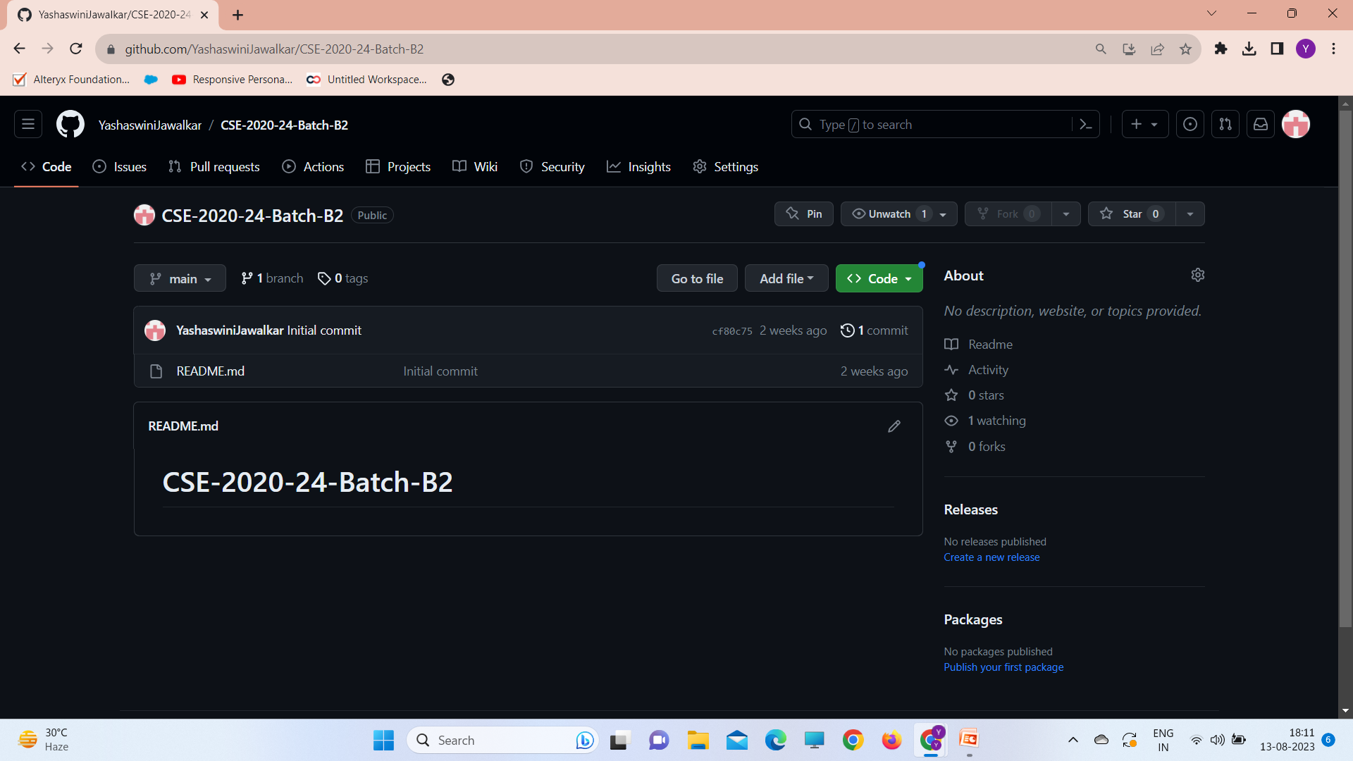
Git Hub Dashboards of each student
https://github.com/YashaswiniJawalkar/CSE-2020-24-Batch-B2.git

Slide 12
Any Queries?

